Slide 1
ItemsControl

Slide 2
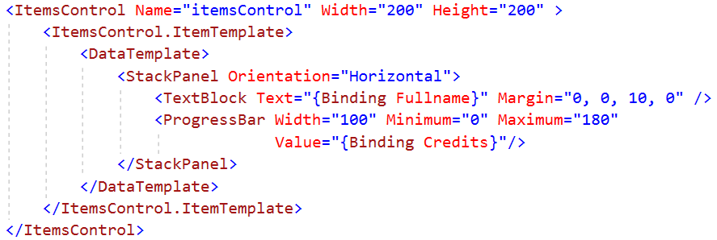
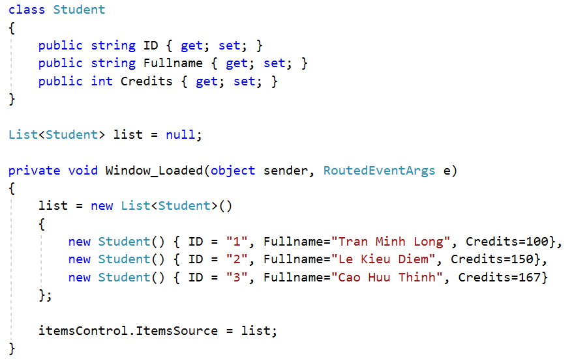

Items control

Slide 3
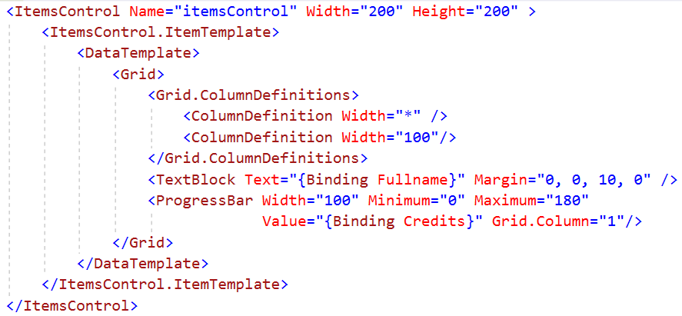

Better with grid

Slide 4
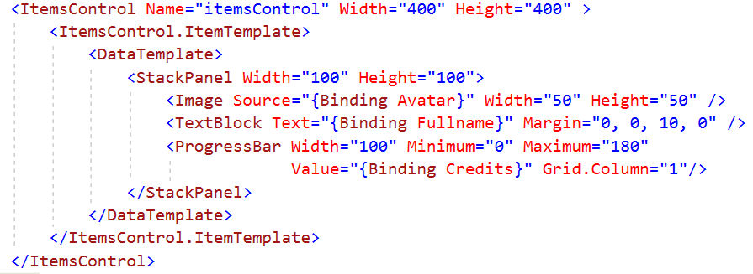

How about collection?
Can we customized this instead of vertical?

Slide 5
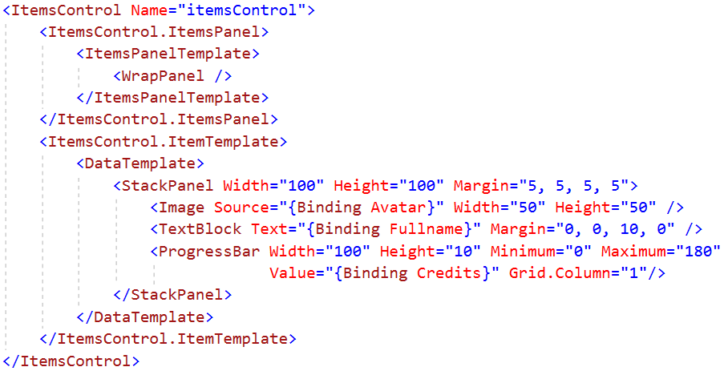
ControlTemplate

Slide 6


Result?

Slide 7
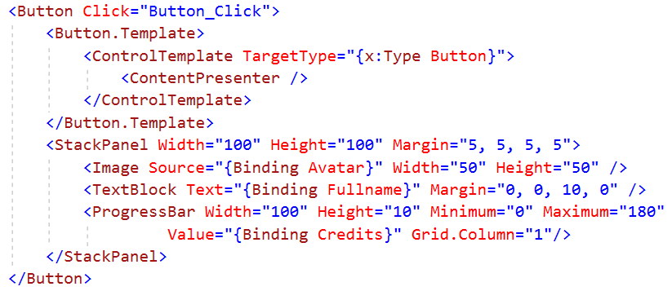
Making item clickable
Wrap all inside an invisible button

Slide 8
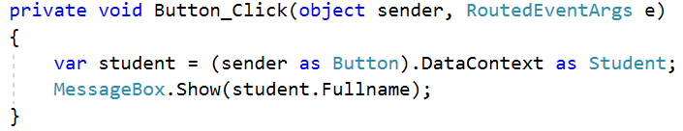
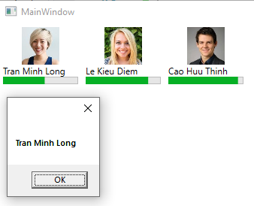
Accessing clicked item
DataContext

Slide 9
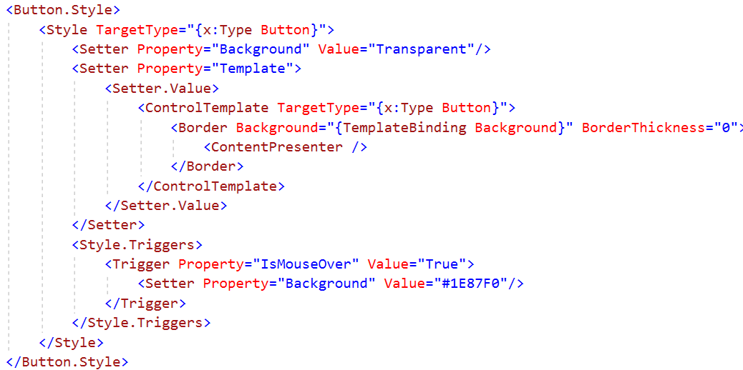

Mouse over effect

Slide 10
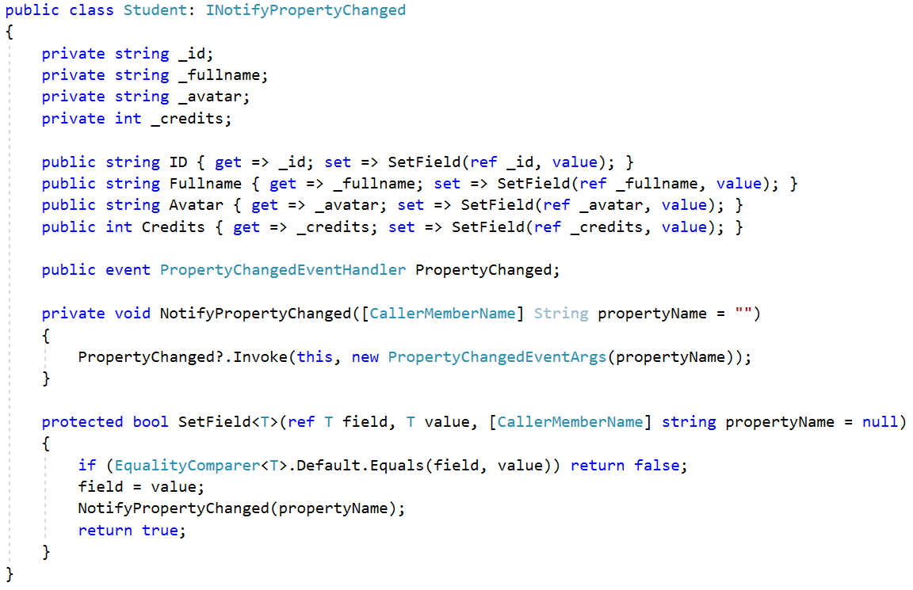
Make class notify changed
Notes:
Protected bool SetField<T>(ref T field, T value, [CallMemberName] string propertyName = null)
{
if (EqualityComparer<T>.Default.Equals(field, value)) return false;
field = value;
NotifyPropertyChanged(propertyName);
return true;
}
private void NotifyPropertyChanged(string propertyName = “”)
{
PropertyChanged?.Invoke(this, new PropertyChangedEventArgs(propertyName));
}

Slide 11
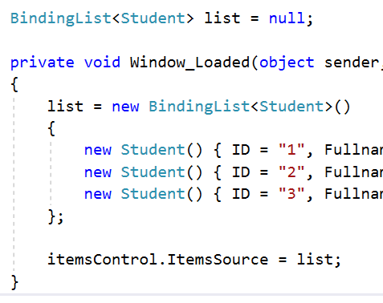
Change list to binding list

Slide 12
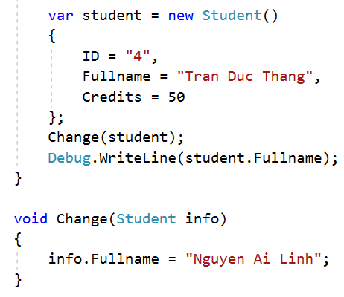
Understand reference
The parameter may be understood as pass by value
Is it?

Slide 13
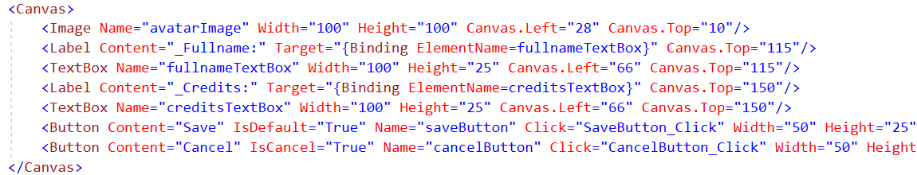
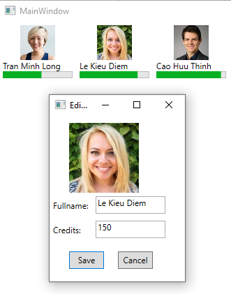
Create an edit window

Slide 14
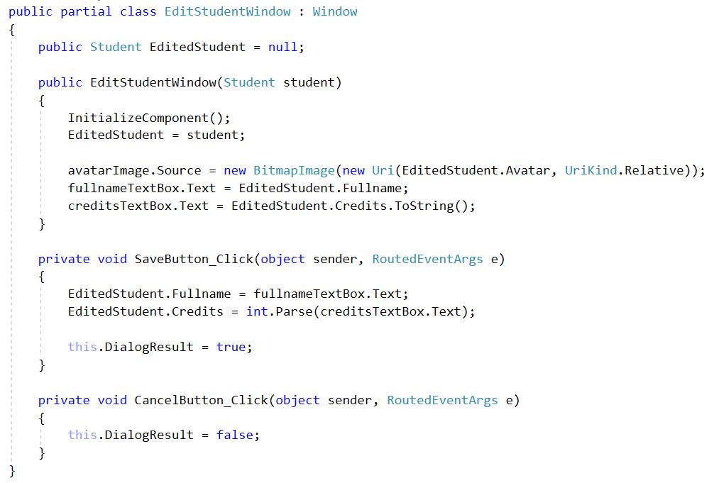
Code behind

Slide 15
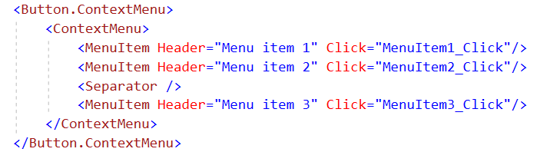
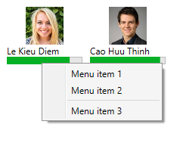
Popup menu

Slide 16
Homework
Read all your items from Excel file
Dislay list of all item in collection fashion
Add, Update, Delete an item

